Slide 1

BE THE FORCE FOR GOOD-LOCALLY AND GLOBALLY

Slide 2
INTRODUCTION TO CLOUD COMPUTING
ROHAN RAJ

Slide 3
What's a bulb doing here?

Slide 4


What is Cloud?

Slide 5
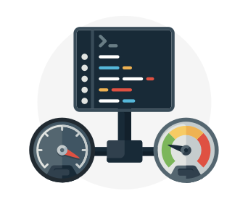
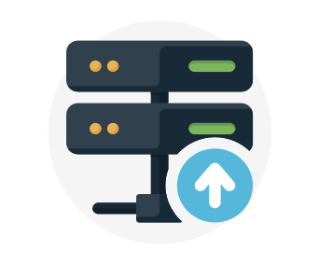
Cloud Computing Services
Compute power - such as Linux servers or web applications
Storage - such as files and databases
Networking - such as secure connections between the cloud provider and your company
Analytics - such as visualizing telemetry and performance data

Slide 6
What are Container?
What is Serverless Computing

Slide 7
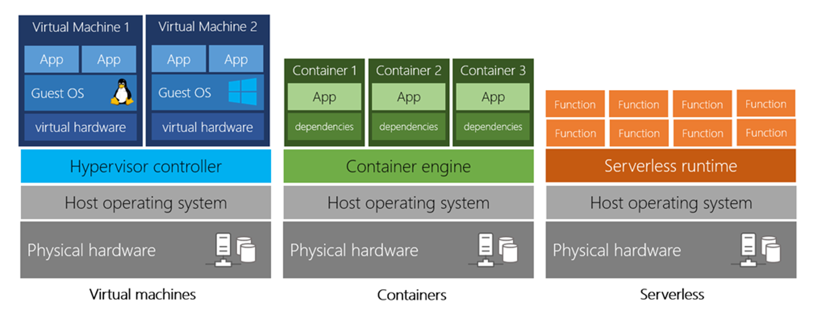

Slide 8
Benefits of Cloud Computing
It’s Cost Effective
It’s Scalable
It’s Elastic
It’s Current
It’s Reliable
It’s Global
It’s Secure

Slide 9
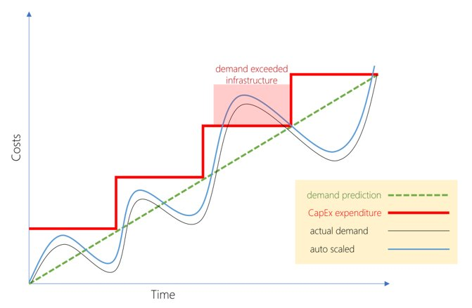
Capital expenditure (CapEx) versus Operational expenditure (OpEx)

Slide 10



Cloud deployment models
PUBLIC CLOUD
PRIVATE CLOUD
HYBRID CLOUD

Slide 11

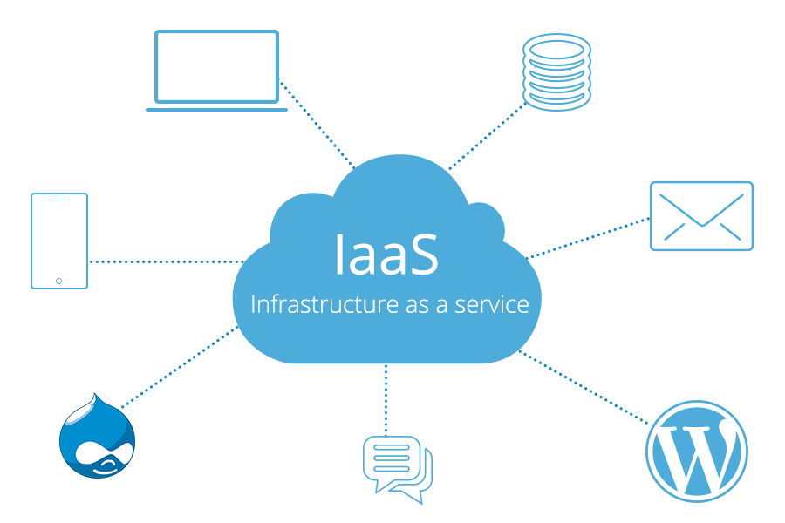


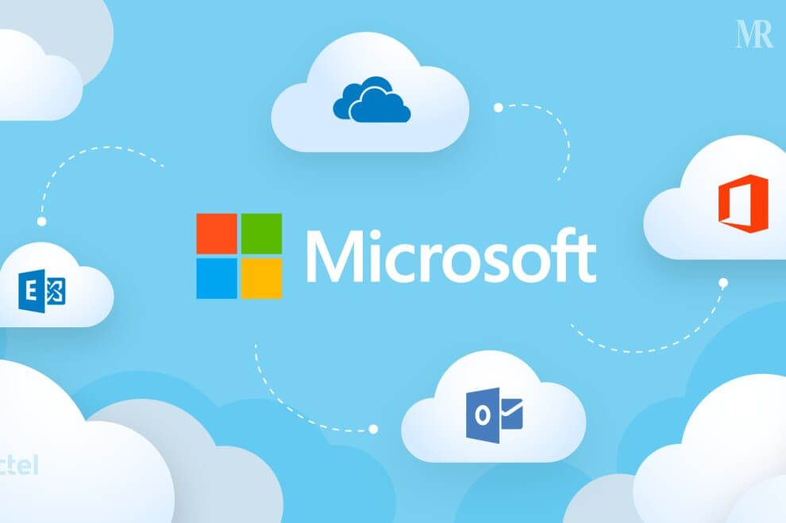
TYPES OF CLOUD SERVICES
INFRASTRUCTURE AS A SERVICE
PLATFROM AS A SERVICE
SOFTWARE AS A SERVICE

Slide 12
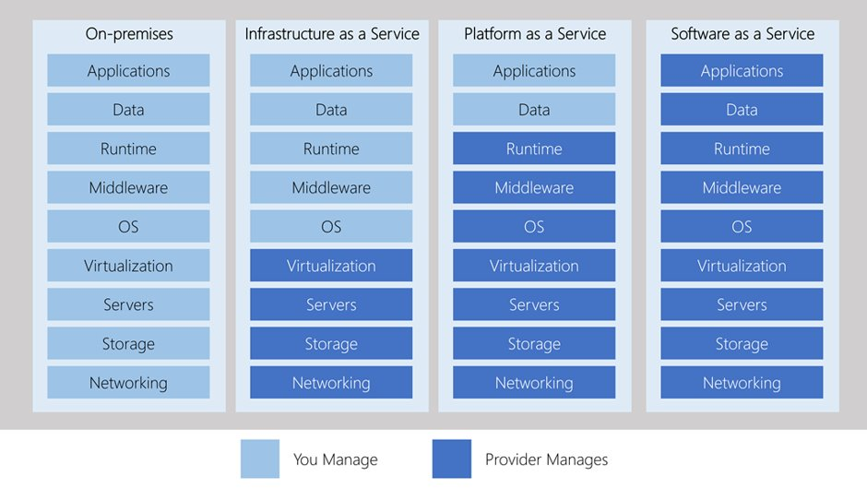

Slide 13
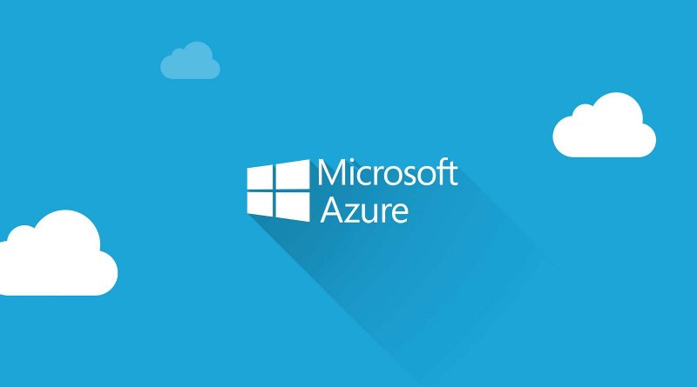

Slide 14
HOW DOES AZURE WORK?

Slide 15
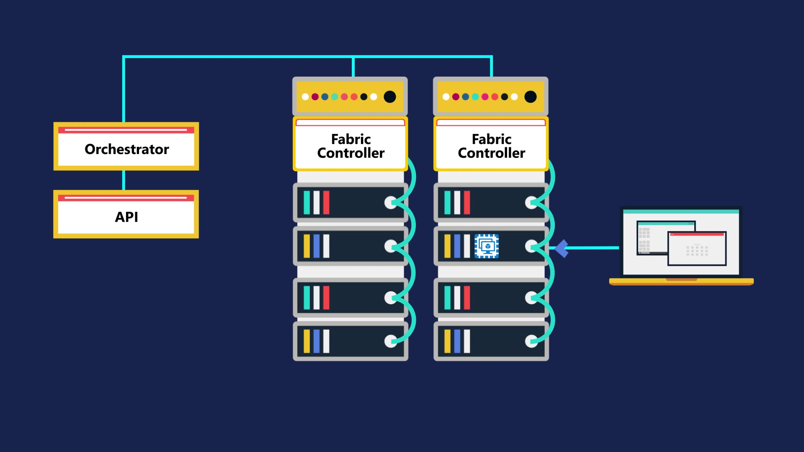

Slide 16

Learn more about Cloud on MS Docs: https://docs.microsoft.com/en-gb/learn/paths/azure-fundamentals/

